Slide 1
Project 2: Regression-Movies Box Office
Benny Zheng

Slide 2


Goal:
Attempting to build a Linear regression model to display a relationship between Gross Domestic Sales and the various features related to a movie.

Slide 3
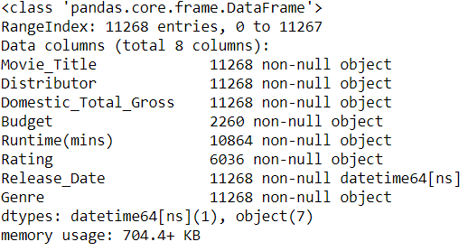
Collected Data
1st collect some data

Slide 4
Collected Data
1st collect some data
1-(2260/11268)==>79.94%
~80% Missing

Slide 5
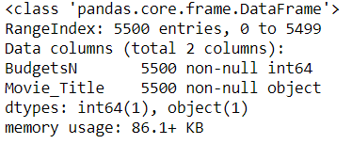
Collected Data
Okay, 5500 movie budgets from The-Numbers

Slide 6
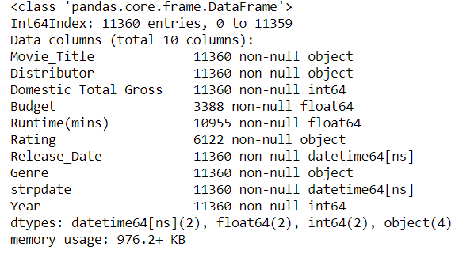
Collected Data
Combine based on Movie Title for 1062 more than we started with.

Slide 7
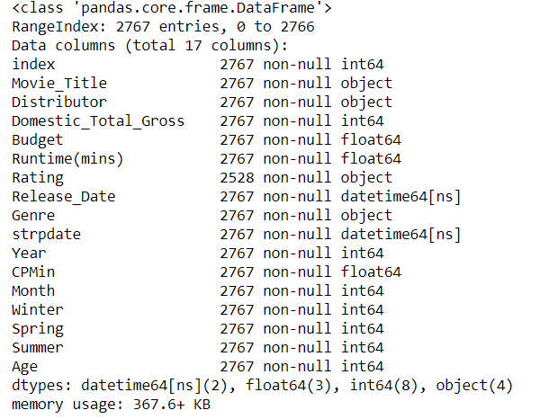
Collected Data
Dropped the duplicates

Slide 8
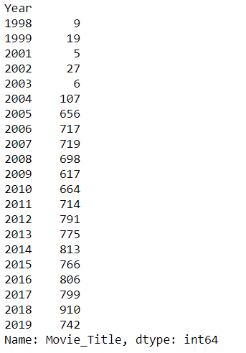
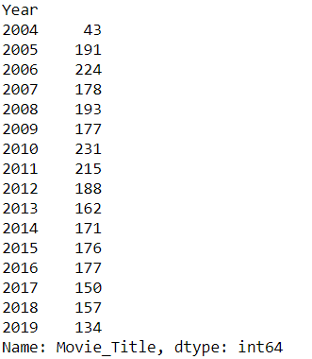
Collected Data
Filtered
Starting

Slide 9
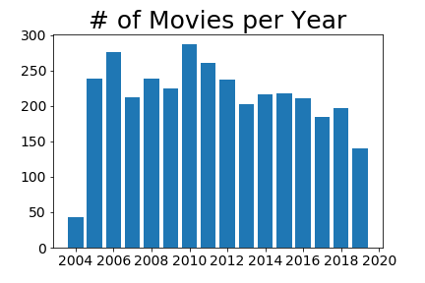
Collected Data
Filtered
Starting

Slide 10
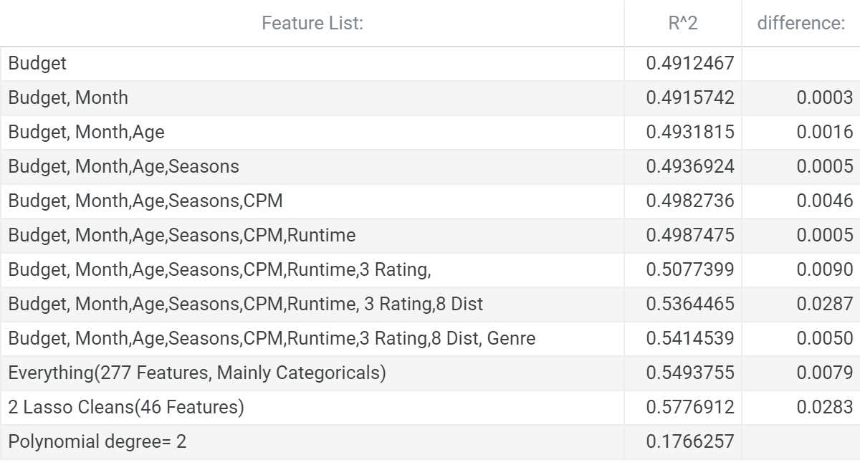
Model Adjustments
<==w/o budget 0.5022925980754136
A difference of nearly .04

Slide 11
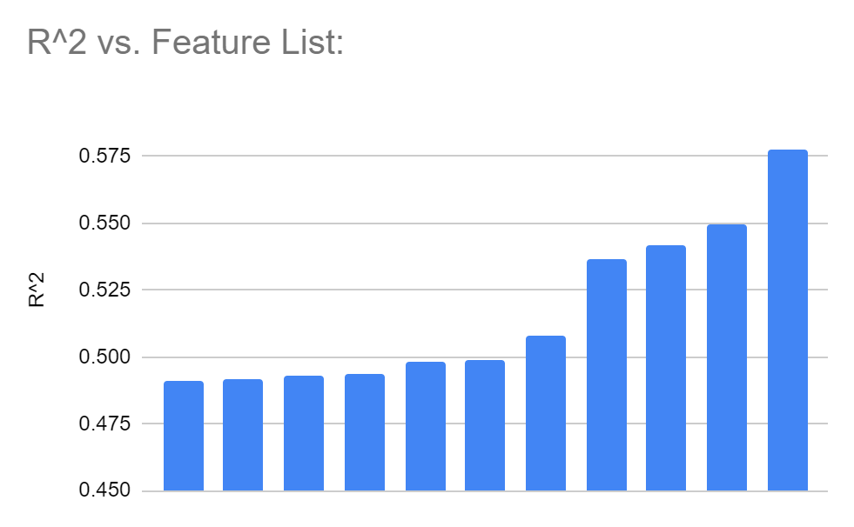
Model Adjustments

Slide 12
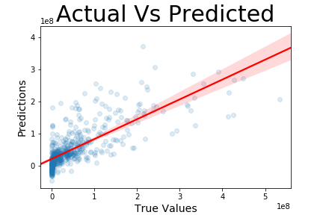
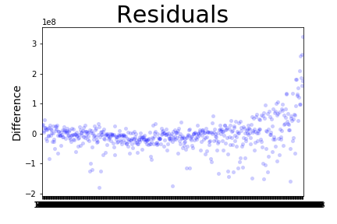
Ending Model

Slide 13
Future Work
Try to find more complete data
Improve Filtering Parameters
Low/High end
Gathering more base features:
Reviews-User/Critic
Sequel?
Involved parties - Directors, Producers, Actors
Combining together with another dataset all together
Actor/director contract values throughout their careers

Slide 14
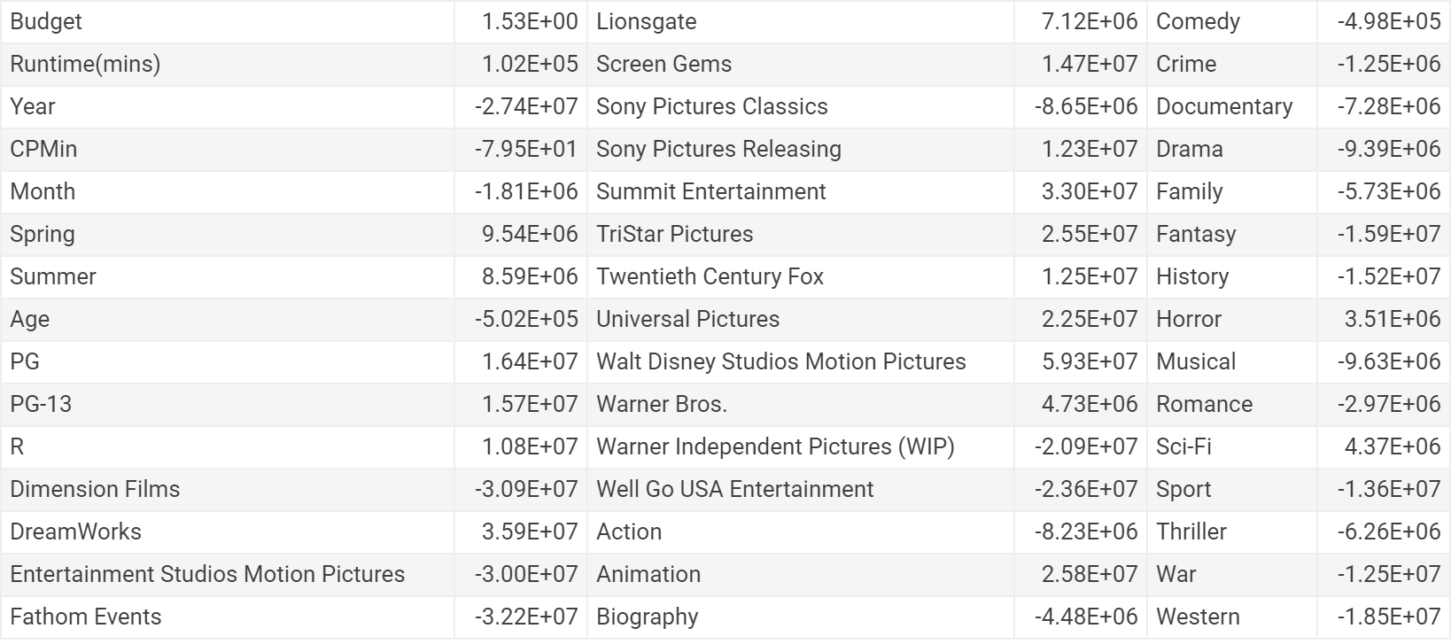
Coefficients

Slide 15
Questions?

